Slide 1
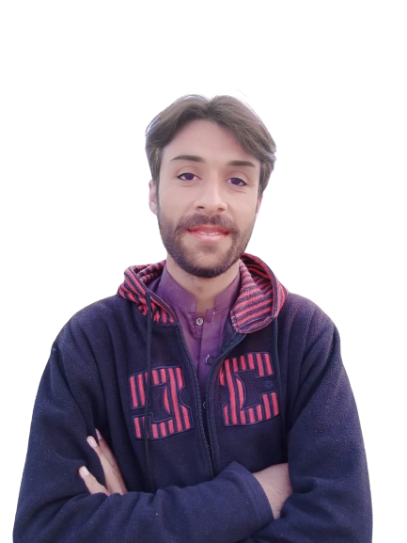
Intermediate Task Series
Problem Number 78

Slide 2
Problem Statement
Create a Desktop Python program to create a window and Insert some text to window

Slide 3
Algorithm
Step1: Import a Tkinter Package
Step2: Create a basic window
Step3: Set a window title
Step4: Create a Label widget to insert text in a window
Step5: Dispaly a result to user
END

Slide 4
Assignment
Create a Desktop Python program to create a window and Insert some text to window. Also change label color, background color etc

